Slide 1
Notes:
Representative Democracy and You
[This module is designed for legislators or teachers to introduce The American Democracy Game to students.]

Slide 2
Notes:
Start a discussion with the students: What are some ways that government affects your daily life?

Slide 3
Notes:
This list is designed to validate and supplement the ideas that the students suggest.

Slide 4
Notes:
Start a discussion with the students: What kind of government do we have?

Slide 5
Notes:
Our form of government is a Representative Democracy. It is also called a Republic.
[Continued on next slide]

Slide 6
Notes:
Describe how legislators are elected in your state legislature or city council or school board…These representatives work together to make the laws we live by.

Slide 7
Notes:
Start a discussion with the students: What kinds of people become our elected representatives?

Slide 8
Notes:
Legislators: Explain your own background. Mention some of your colleagues who have interesting backgrounds.
Teachers: Look up the backgrounds of some of your local elected representatives.

Slide 9
Notes:
Start a discussion with the students: How do representatives come up with the right answers to make laws?

Slide 10
Notes:
As representatives, we learn as much as we can about an issue. One important way we do that is to hold committee meetings where anyone in the public can express their views on an issue. We also hear from all the groups or organizations that might be affected by our decision.
[Continued on next slide]

Slide 11
Notes:
After we hear public testimony, we discuss and debate proposed laws. A majority is necessary to make a decision, so we sometimes have to work together to find common sense solutions.
[Continued on next slide]

Slide 12
Notes:
Give an example of a bill in your legislature that does not have a clear solution. Talk about issues that are important to kids like school uniforms, violence, driving age, helmets for bicyclists or rollerbladers, video game restrictions, smoking on campus, graffiti, competency testing to graduate, and curfews.
[Continued on next slide.]

Slide 13
Notes:
Tell a story about compromise in your own experience.

Slide 14
Notes:
Start a discussion with the students: How can you actively participate in American democracy?

Slide 15
Notes:
Vote— Even if you’re not old enough to vote, you can find out who your representatives are.
Stay Informed— Educate yourself about the issues.
Discuss Politics and Current Events— Come up with solutions, not just problems.
Don’t Go It Alone — Join with others who share your point of view.
Be Heard— Stay in touch with your elected officials. (Write, email, or call your representatives. Meet them at a public event, or at their office.)

Slide 16
Notes:
How can we learn more?

Slide 17
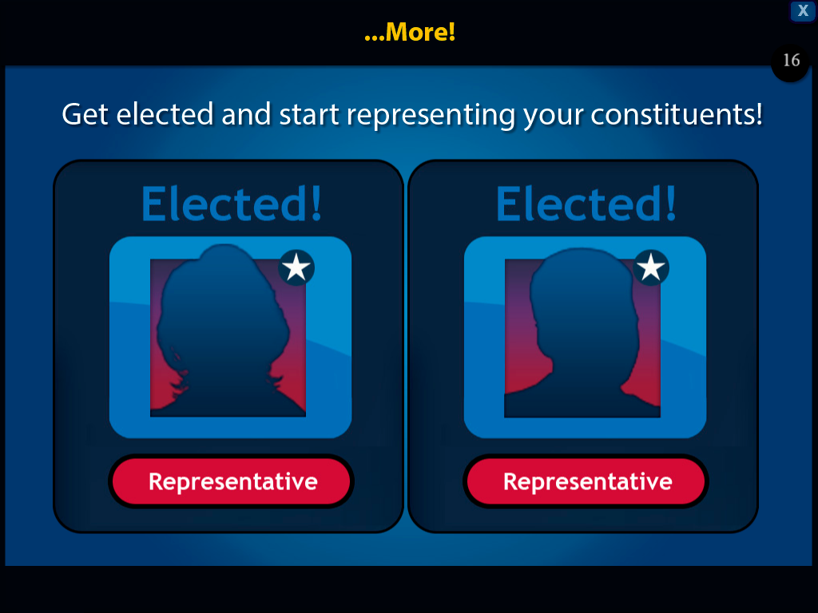
Notes:
One way to get a better idea of what a representative does is to become one yourself! Get elected and start representing your constituents!

Slide 18
Notes:
You, along with your fellow representatives, make the laws.
You can become an elected official by playing the American Democracy Game!

Slide 19
Notes:
I hope you enjoy the game and learn more about our system of American Democracy!

